Slide 1
From Excel via SQL to MapReduce to SparkSQL
Introduction to parallel computations
Carsten Langer
2016-08-31 Düsseldorf Data Science Meetup

Slide 2

About me
Carsten Langer
Nokia Solutions and Networks, Düsseldorf
20+ years mobile telecommunication, network/service optimization
Since 2015 exploring cloud and big data technologies
xing.com/profile/Carsten_Langer

Slide 3
Self-study
If you self-study this slideset:
use presentation mode to see the step-by-step animations
see the note pages for further explanations

Slide 4
Motivation
This presentation is for you, if …
… during a typical Business Intelligence data analysis you
use Excel
use basic SQL
… you wonder:
How that hype on MapReduce/Hadoop/Spark helps to scale your case?
How would your KPI analysis transform to parallel computation?

Slide 5
Agenda
Simple BI application in Excel
Same in SQL
Scaling-up vertically vs. scaling-out horizontally
Translation to MapReduce
A more complete example
MapReduce, Hadoop, Hive
Spark, SparkSQL
Distributed Storage
Summary

Slide 6
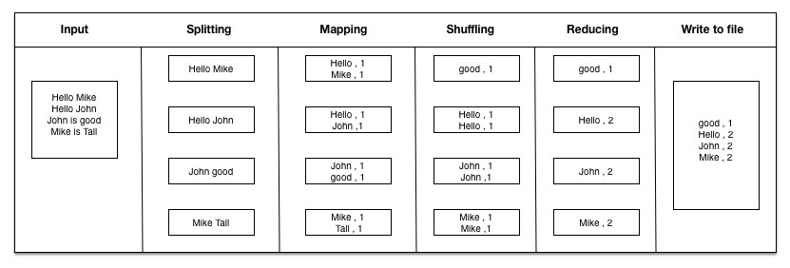
Simple Business Intelligence Application
The “Hello World” program of MapReduce is the famous “WordCount”, counting occurrences of words in some text.
However, you may wonder how does this translate to your use cases?
Thus this presentation uses a different KPI as basis.
?
source: https://tutorials.techmytalk.com/2014/08/08/hadoop-map-reduce/

Slide 7
Simple Business Intelligence Application
Given: List of start and end values (Time, €, goods, …)
Wanted: Average/mean of differences between end and start
Example:
Start | End
5 | 7
2 | 3
6 | 10
End - Start
2
1
4
AverageDiff
2.33

Slide 8
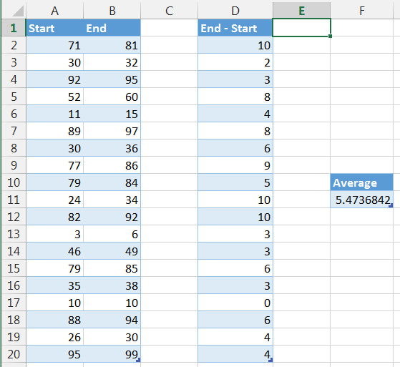
BI App in Excel
=B2-A2
=AVERAGE(D2:D20)

Slide 9
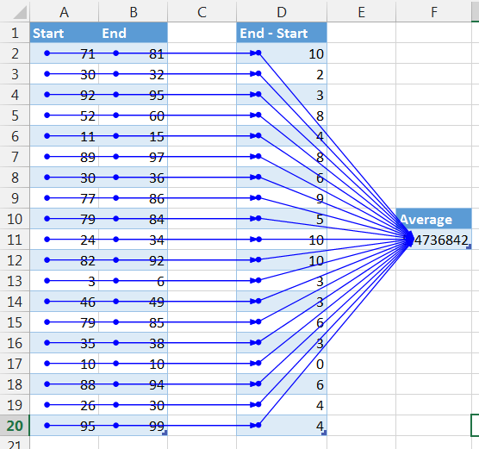
BI App in Excel
What is a DAG?
Excel executes formulas as Directed Acyclic Graphs
Directed preceding → current → depending cell
Acyclic No dependency cycles
Graph Use Formulas->Trace… to show
Notes:
For formula execution order, Excel creates Directed Acyclic Graphs
Directed: For each cell Excel knows which other cell(s) it depends on
Acyclic: No dependency cycles (Excel would complain on cycles)
Graph: Cells connected by links, use Formulas->Trace… to show

Slide 10
BI App in Excel
What is a DAG?
DAG recalculation:
A changed cell triggers recalculation only along affected DAG-branch
change

Slide 11
BI App in Excel
What is a DAG?
DAG calculation:
Independent parts (blue) can process in parallel
Dependent parts (red) have to wait for dependencies

Slide 12

BI App in Excel
Would it scale?
☺ Multithreaded DAG calculation
☹ Max 1,048,576 rows
☹ Slow with big files
Scaling?
Notes:
Good:
Excel uses all CPU cores in parallel to compute the DAG-branches.
But:
Old Excel limited to 65,535 rows.
Modern Excel limited to 1,048,576 rows.
Loading, processing, saving gets slow beyond a certain size.
Excel does not scale.

Slide 13
Agenda
Simple BI application in Excel
Same in SQL
Scaling-up vertically vs. scaling-out horizontally
Translation to MapReduce
A more complete example
MapReduce, Hadoop, Hive
Spark, SparkSQL
Distributed Storage
Summary

Slide 14
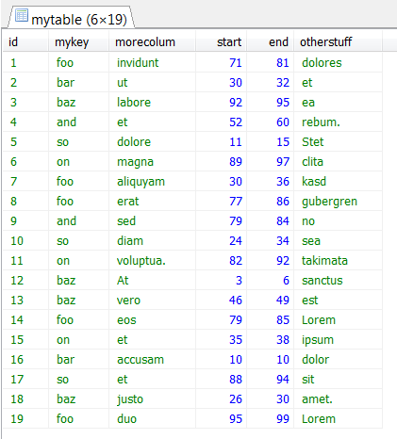

BI App in SQL
SQL at example of MySQL
select
avg(end - start) as avgdiff
from mytable

Slide 15
BI App in SQL
What happens during SQL execution – Pseudocode
sum := 0
count := 0
Repeat
read 1 full row of table mytable from disk
start := extract from row the value for column start
end := extract from row the value for column end
diff := end – start
sum := sum + diff
count := count + 1
Until all rows read
avgdiff := sum / count

Slide 16
BI App in SQL
Would it scale?
SQL
☺ “Unlimited” number of rows
☹ RDBMS
Scaling?
SQL

Slide 17
SQL and RDBMS
SQL = what columns, rows, content
Database system = how
Often: SQL ⬄ RDBMS, e.g. MySQL, PostgreSQL, ...
Notes:
In SQL = Structured Query Language you define the what of a result: the columns, rows, content of the output.
The database system defines how to get there.
Often when using SQL you think of a typical database system like a RDBMS (Relational Database Management System) like e.g. MySQL.

Slide 18
Relational Database Management System
Typically 1 query = 1 CPU thread
Data stored in rows → read full row to extract column value → disk I/O can become bottleneck
Optimized for transactions (OLTP)
Suboptimal for analytics (OLAP)
Notes:
Normal RDBMS (Relational Database Management System):
Stores data in rows, always full row must be read to extract column values. Disk I/O can become bottleneck.
Typically executes each SELECT query in a single CPU thread.
Is optimized for normalized data as used in OLTP (parallel transaction processing, e.g. customer management, web shop).
Is suboptimal for denormalized data as used in OLAP (single analytical reporting, e.g. BI applications requiring full-table-scans).

Slide 19
BI App in SQL
Would it scale?
Multi-threading of single SELECT:
Depends on DBMS and circumstances
E.g. MySQL can’t, others can (link, link)
Notes:
Database engines supporting multi-threaded SELECTs mentioned in the links are: infiniDB, Infobright IEE, SQL Server. There are others around as well.

Slide 20
BI App in SQL
Would it scale?
I/O bottleneck for reading all rows and full rows:
Better data model -> shorter rows
Faster disks
More memory → in-memory databases

Slide 21
BI App in SQL
Would it scale?
Columnar databases:
Storage layout in columns, not rows
Same SQL frontend, different backend
Better suited for BI applications

Slide 22
BI App in SQL
Would it scale?
SQL
☺ “Unlimited” number of rows
☹ RDBMS Non-parallel execution Row storage → I/O bottleneck
Scaling?
SQL

Slide 23
Agenda
Simple BI application in Excel
Same in SQL
Scaling-up vertically vs. scaling-out horizontally
Translation to MapReduce
A more complete example
MapReduce, Hadoop, Hive
Spark, SparkSQL
Distributed Storage
Summary

Slide 24

Vertical Scaling vs. Horizontal Scaling
Vertical scaling / scale-up:
Keep single node
Faster disk
More RAM
Faster CPU
More CPUs (*)
→ Single expensive machine
Vertical Scaling
Notes:
(*) if application and RDBMS supports splitting problem in multiple parallel threads

Slide 25
Vertical Scaling vs. Horizontal Scaling
Horizontal scaling /scale-out:
Split problem in parallelizable tasks
Add more nodes to a cluster
Total aggregated disk I/O, RAM, CPU exceeds single node
→ Many inexpensive machines
Horizontal Scaling

Slide 26
Vertical Scaling vs. Horizontal Scaling
Tradeoffs
Traditionally, price difference had favored vertical scaling / scale up.
Buying, installing and configuring a “real” new system was expensive.
Just upgrading an existing system was cheaper.

Slide 27
Vertical Scaling vs. Horizontal Scaling
Tradeoffs
Today favor changes towards horizontal scaling / scale out.
Adding a node is cheap!
Virtualization
Virtual Machines
Hosting
Pay-per-use
Automa- tion
Cloud
XaaS
Notes:
Virtualization systems (hypervisor/virtual machine/cloud) make creating a new “virtual” system cheap.
Pay-per-usage allows to save money if resources are not used, and pushes you for automation.
Provisioning, setup, configuration is often automated, thus cheap.

Slide 28
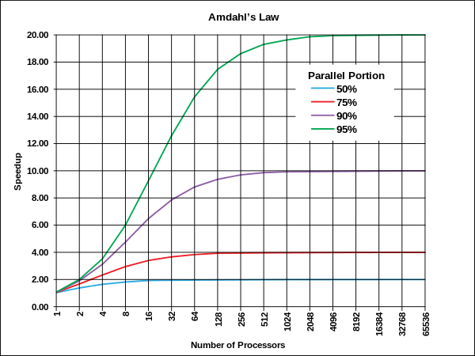
Vertical Scaling vs. Horizontal Scaling
Tradeoffs
However, with larger numbers of computers
increased management complexity
more complex programming model
issues like throughput and latency between nodes
And not all problems parallelize well.
source: wikipedia
CC BY-SA 3.0

Slide 29
Agenda
Simple BI application in Excel
Same in SQL
Scaling-up vertically vs. scaling-out horizontally
Translation to MapReduce
A more complete example
MapReduce, Hadoop, Hive
Spark, SparkSQL
Distributed Storage
Summary

Slide 30
Translation to Parallel Cluster-based Computing
How to parallelize the task?
Start from CSV file
1st task: per row, extract start and end and return difference diff
2nd task: sum up differences and count them
3rd task: final result := sum/count
Parallelizable
ID;MyKey;MoreColum;Start;End;OtherStuff
1;foo;invidunt;71;81;dolores
2;bar;ut;30;32;et
3;baz;labore;92;95;ea
4;and;et;52;60;rebum.
5;so;dolore;11;15;Stet
6;on;magna;89;97;clita
7;foo;aliquyam;30;36;kasd
…
1st
Start, End
71, 81
30, 32
92, 95
52, 60
11, 15
89, 97
30, 36
…
diff
10
2
3
8
4
8
6
…
2nd
3rd
sum
41
count
7
avgdiff
5.8

Slide 31
Translation to Parallel Cluster-based Computing
Parallelization of 1st task
Start from CSV file
Split input file(s) into partitions
Header line: ignore
Partition 1
Partition 2
Partition 3
ID;MyKey;MoreColum;Start;End;OtherStuff
1;foo;invidunt;71;81;dolores
2;bar;ut;30;32;et
3;baz;labore;92;95;ea
4;and;et;52;60;rebum.
5;so;dolore;11;15;Stet
6;on;magna;89;97;clita
7;foo;aliquyam;30;36;kasd
8;foo;erat;77;86;gubergren
9;and;sed;79;84;no
10;so;diam;24;34;sea
11;on;voluptua.;82;92;takimata
12;baz;At;3;6;sanctus
13;baz;vero;46;49;est
14;foo;eos;79;85;Lorem
15;on;et;35;38;ipsum
16;bar;accusam;10;10;dolor
17;so;et;88;94;sit
18;baz;justo;26;30;amet.
19;foo;duo;95;99;Lorem

Slide 32
Translation to Parallel Cluster-based Computing
Execute 1st task
Give each partition to a separate node.
Then run 1st task.
Node1
diff
10
2
3
8
4
8
6
1;foo;invidunt;71;81;dolores
2;bar;ut;30;32;et
3;baz;labore;92;95;ea
4;and;et;52;60;rebum.
5;so;dolore;11;15;Stet
6;on;magna;89;97;clita
7;foo;aliquyam;30;36;kasd
1st task
Node2
diff
9
5
10
10
3
3
6
8;foo;erat;77;86;gubergren
9;and;sed;79;84;no
10;so;diam;24;34;sea
11;on;voluptua.;82;92;takimata
12;baz;At;3;6;sanctus
13;baz;vero;46;49;est
14;foo;eos;79;85;Lorem
1st task
Node3
…
NodeN
NodeN
Notes:
Technically, the 1st task is a map task.

Slide 33
Translation to Parallel Cluster-based Computing
Execute 2nd task, collect, 2nd task again, 3rd task
Run 2nd task first on each node
Collect intermediate results to single node
Run 2nd task again on collected results
Finally run 3rd task
Node1
diff
10
2
3
8
4
8
6
2nd
NodeX
sum
41
count
7
sum
41
count
7
collect
2nd
sum
46
count
7
Node2
diff
9
5
10
10
3
3
6
2nd
…
…
sum
87
count
14
sum
46
count
7
3rd
Node3
…
NodeN
avgdiff
6.2
NodeN
Notes:
Technically, the 2nd task which is executed on each node is a “combine” task. The 2nd task executed on the NodeX is a “reduce” task. The combine task is optional, but without it all diff values would need to be transported to a central node before summing and counting.

Slide 34
Simplistic MapReduce
The shown process is basically a much simplified MapReduce algorithm.
Map ⬄ 1st task to map 1 line of CSV to 1 diff value.
Reduce ⬄ 2nd task to reduce many diff values to single sum/count.

Slide 35
Simplistic MapReduce
MapReduce basic principle:
Partition the input, let each node work on part of the input.
For each input (e.g. 1 line of CSV) map input to output, in parallel on all nodes.
Reduce outputs in parallel on all nodes.
Collect intermediate results, reduce again and aggregate final result.
Notes:
Parallel computation works explicitly well for problems which follow
Commutative law
a + b = b + a
a x b = b x a
Associative law
(a + b) + c = a + (b + c)
(a × b) × c = a × (b × c)
Distributive law
a × (b + c) = a × b + a × c

Slide 36
Review so far
We just saw
Excel and SQL execution and limits
Transformation into parallel execution
Scaling out:
tends to get cheaper than scaling up
waiting time 
computation time (#nodes * time_per_node) 
Notes:
We saw:
Excel and some RDBMS (MySQL) come to their limit with some data sets.
Some data and calculations can well be transformed into parallel execution.
Scaling out today tends to get cheaper than scaling up
Resources only paid-per-usage
Resources quickly brought up and shut down (automation)
Cluster resources shared between applications
Scaling out brings down waiting time compared to single node execution.
Total computation time (#nodes * time_per_node) may go up.

Slide 37
Agenda
Simple BI application in Excel
Same in SQL
Scaling-up vertically vs. scaling-out horizontally
Translation to MapReduce
A more complete example
MapReduce, Hadoop, Hive
Spark, SparkSQL
Distributed Storage
Summary

Slide 38
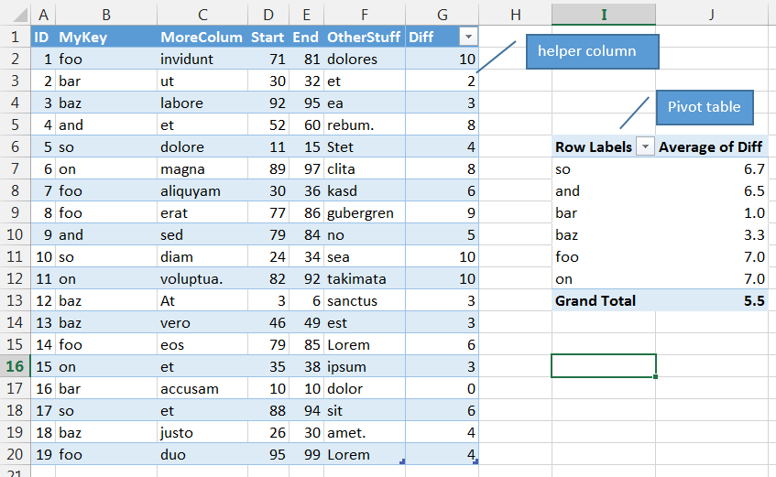
More Complete Example – Excel
A more complete example is this task:
Calculate the average difference grouped by key MyKey.
In Excel this requires a helper column for Diff and a Pivot table for grouping.

Slide 39
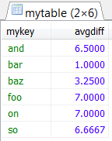
More Complete Example – SQL
SQL with grouping:
select
mykey,
avg(end - start) as avgdiff
from mytable
group by mykey
Little change in SQL, big change in performance!

Slide 40
More Complete Example – Translation to MapReduce
MapReduce is mapping one input <key, value> pair to output <key, value> pairs.
1st task: per line in file, extract mykey, start and end, calculate diff
<unusedkey, linecontent> → <mykey, end – start>
2nd task: re-group <key, value> pairs by keys
ID;MyKey;MoreColum;Start;End;OtherStuff
1;foo;invidunt;71;81;dolores
2;bar;ut;30;32;et
3;baz;labore;92;95;ea
4;and;et;52;60;rebum.
5;so;dolore;11;15;Stet
6;on;magna;89;97;clita
7;foo;aliquyam;30;36;kasd
…
1st
<k, v>
foo, 10
bar, 2
baz, 3
and, 8
so, 4
on, 8
foo, 6
…
2nd
<k, v>
foo, 10
foo, 6
…
<k, v>
and, 8
and, 5
…
…
<k, v>
on, 8
on, 10
…

Slide 41
More Complete Example – Translation to MapReduce
Status after 2nd task:
3rd task: per key, summarize and count values and calculate the average. Per key: List of <mykey, diff> → <mykey, avgdiff>
<k, v>
foo, 10
foo, 6
…
<k, v>
and, 8
and, 5
…
<k, v>
on, 8
on, 10
…
3rd
…
<k, v>
foo, 7.0
<k, v>
and, 6.5
<k, v>
on, 7.0

Slide 42
More Complete Example – Parallel Execution
Map
1st task:
On each node, take CSV file partitions
and map lines to <k, v>.
Node1
<k, v>
foo, 10
bar, 2
baz, 3
and, 8
so, 4
on, 8
foo, 6
1;foo;invidunt;71;81;dolores
2;bar;ut;30;32;et
3;baz;labore;92;95;ea
4;and;et;52;60;rebum.
5;so;dolore;11;15;Stet
6;on;magna;89;97;clita
7;foo;aliquyam;30;36;kasd
1st task
Node2
<k, v>
foo, 9
and, 5
so, 10
on, 10
baz, 3
baz, 3
foo, 6
8;foo;erat;77;86;gubergren
9;and;sed;79;84;no
10;so;diam;24;34;sea
11;on;voluptua.;82;92;takimata
12;baz;At;3;6;sanctus
13;baz;vero;46;49;est
14;foo;eos;79;85;Lorem
1st task
Node3
…
NodeN
NodeN
Notes:
Technically the 1st task is the map task.

Slide 43
More Complete Example – Parallel Execution
Grouping/Preparation for Shuffle
2nd task:
Group the key/value pairs by keys.
Per Node, per key have one list of <k, v>.
Node1
<k, v>
foo, 10
bar, 2
baz, 3
and, 8
so, 4
on, 8
foo, 6
2nd task
<k, v>
foo, 10
foo, 6
<k, v>
baz, 3
<k, v>
and, 8
…
Node2
<k, v>
foo, 9
and, 5
so, 10
on, 10
baz, 3
baz, 3
foo, 6
2nd task
<k, v>
foo, 9
foo, 6
<k, v>
baz, 3
baz, 3
<k, v>
and, 5
…
Node3
…
NodeN
NodeN
Notes:
Here there is no combine task used.

Slide 44
More Complete Example – Parallel Execution
Shuffle
Then shuffle the lists between nodes so that each key is collected at one node.
Node1
Node1
<k, v>
foo, 10
foo, 6
<k, v>
baz, 3
<k, v>
and, 8
Shuffle
<k, v>
foo, 10
foo, 6
<k, v>
foo, 9
foo, 6
<k, v>
foo, 4
…
Node2
Node2
<k, v>
foo, 9
foo, 6
<k, v>
baz, 3
baz, 3
<k, v>
and, 5
<k, v>
baz, 3
<k, v>
baz, 3
baz, 3
<k, v>
baz, 4
…
Node3
Node3
<k, v>
foo, 4
<k, v>
baz, 4
<k, v>
and, 8
<k, v>
and, 5
…
Notes:
Here there is no combine task used. Thus per key the full lists of <k, v> are transported to the other node.

Slide 45
More Complete Example – Parallel Execution
Reduce
3nd task: Reduce the lists of same keys, calculate average.
MR results are written to disk as separate files.
Node1
Node1
<k, v>
foo, 10
foo, 6
<k, v>
foo, 9
foo, 6
<k, v>
foo, 4
3rd task
<k, v>
foo, 7.0
Optionally: 4th task Collect final results
Node2
Node2
Node0
<k, v>
baz, 3
<k, v>
baz, 3
baz, 3
<k, v>
baz, 4
<k, v>
baz, 3.25
<k, v>
foo, 7.0
baz, 3.25
and, 6.5
Node3
Node3
<k, v>
and, 8
<k, v>
and, 5
<k, v>
and, 6.5
Notes:
As there was no combine task, each node now has collected per key the lists of <k, v> and can for this key calculate the average by going through all lists, calculating the sum and count and finally the average.
If one would like to use a combine task, it gets more complicated. The reason is, that the result of the combine task would need to be key, sum, count, i.e. 3 values, but technically only a <k, v> pair is possible. So the sum and count must be coded into a single value. How best to do this depends on the implementation, e.g by using 2-tuples of (sum, count). But as an idea, the combiner per node could emit per key a single <k, v> with <mykey, (sum, count)>, and then the reducer per key could reduce a list of <mykey, (sum, count)> to a single <mykey, avgdiff>.

Slide 46
Agenda
Simple BI application in Excel
Same in SQL
Scaling-up vertically vs. scaling-out horizontally
Translation to MapReduce
A more complete example
MapReduce, Hadoop, Hive
Spark, SparkSQL
Distributed Storage
Summary

Slide 47
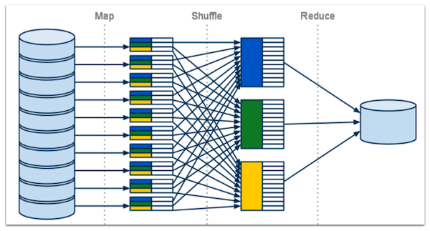
MapReduce, Hadoop, Hive
MapReduce (MR) is just a programming model for distributed, fault-tolerant, and scalable parallel computation.
Source: http://www.kalyanhadooptraining.com/2014/07/introduction-to-hadoop-ecosystem.html

Slide 48

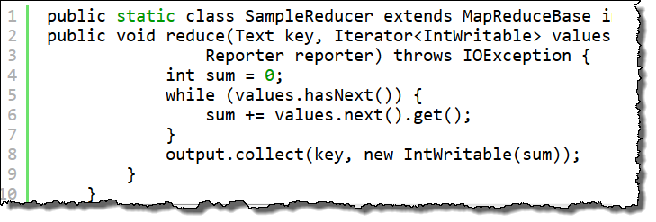

MapReduce, Hadoop, Hive
Apache Hadoop is most popular open source platform for MR.
MR on Hadoop typically implemented as Java code.
→ Executed in batches.
→ Inconvenient to analysts.
Easier to use well-known SQL → Apache Hive.
Hive takes SQL and under-the-hood translates to MR.
Execution delay due to compilation and batch execution of MR.
Notes:
The performace of Hive has improved over time, especially when it runs on Tez.

Slide 49
Agenda
Simple BI application in Excel
Same in SQL
Scaling-up vertically vs. scaling-out horizontally
Translation to MapReduce
A more complete example
MapReduce, Hadoop, Hive
Spark, SparkSQL
Distributed Storage
Summary

Slide 50

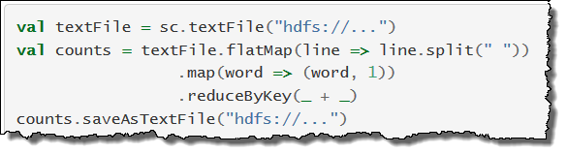
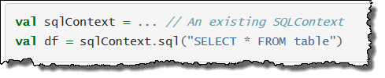
Spark, SparkSQL
Apache Spark is considered the heir of MapReduce.
Much faster than MR, less disk I/O, more in-memory operations.
Different programming model, but on high level uses same principles: input → partition → map → shuffle → reduce → output
Provides batch and interactive execution in Scala, Java, Python. Simpler than MR, but still programming.
→ Solution: SparkSQL Same As Hive SQL, but faster and interactive.

Slide 51
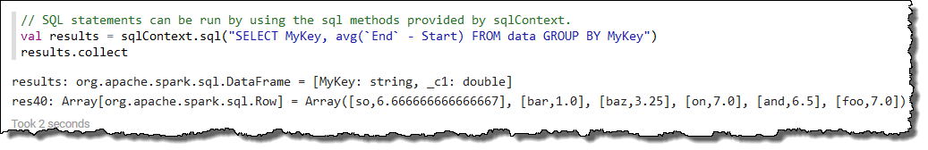
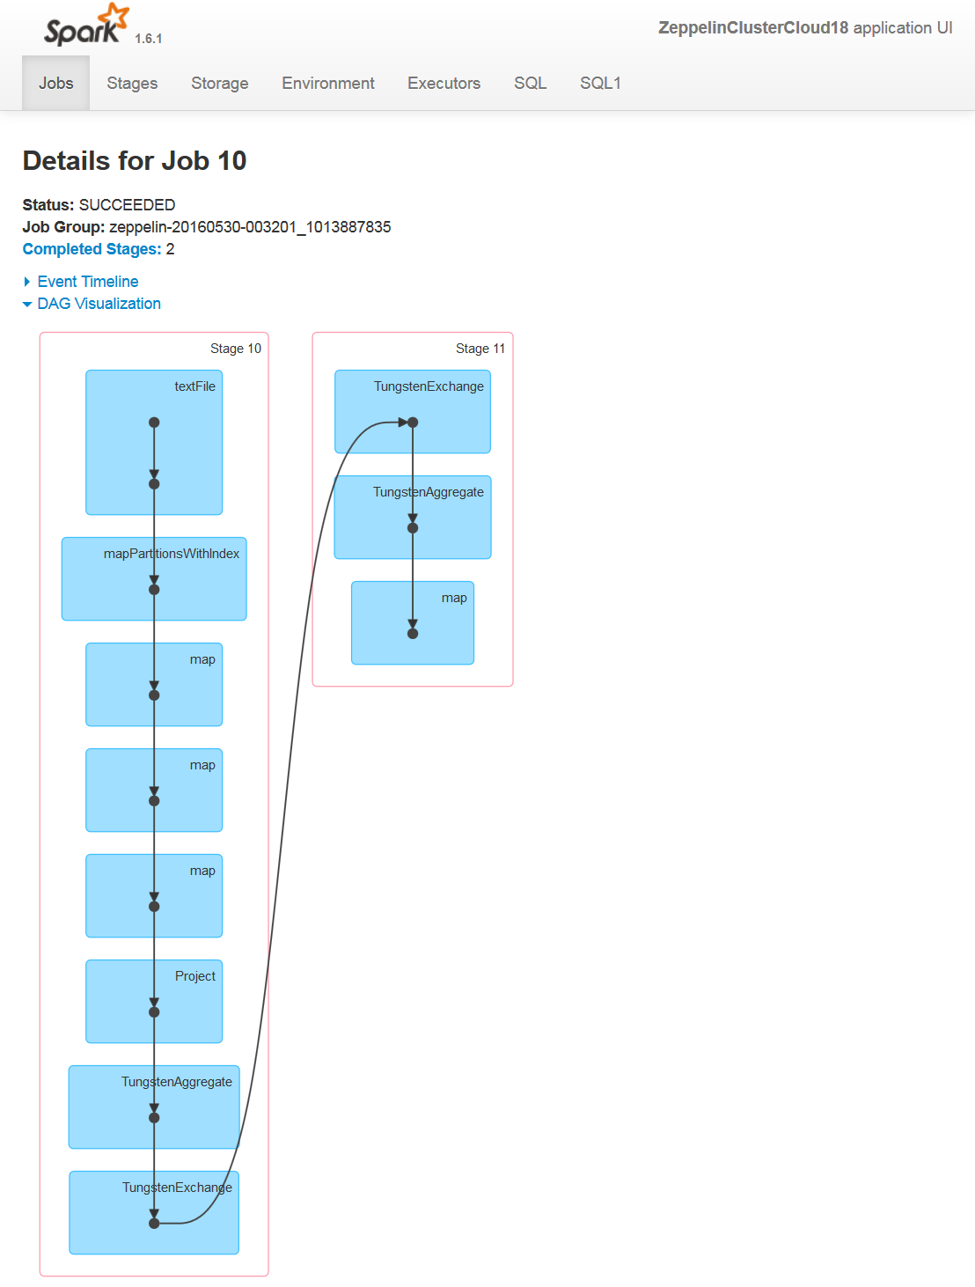
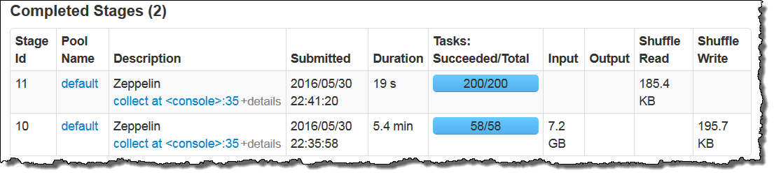
SparkSQL and DAG
SparkSQL translates SQL into a DAG of Spark operations, e.g. map, shuffle, aggregate, …
Cluster executes the DAG in parallel where possible.

Slide 52
SparkSQL and Consequences for Analysts
Good news: You can continue to use SQL!
Gotcha:
In SQL you define the what of a result: the columns, rows, content of the output.
In theory you leave the how to get it to the execution engine.
In practice for acceptable performance, you have to help and guide the execution engine, e.g. use indexes, partitions, chose JOIN vs. Sub-SELECT carefully.
Expectation for transition:
In SparkSQL the basic SQL statement for the what may stay the same.
The details how to optimize the statements will differ → new learning.

Slide 53
Agenda
Simple BI application in Excel
Same in SQL
Scaling-up vertically vs. scaling-out horizontally
Translation to MapReduce
A more complete example
MapReduce, Hadoop, Hive
Spark, SparkSQL
Distributed Storage
Summary

Slide 54
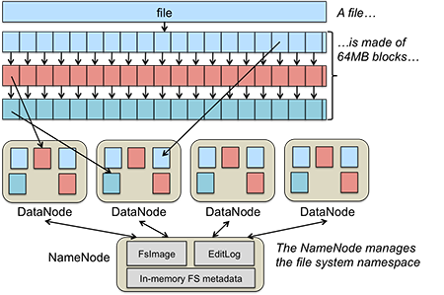

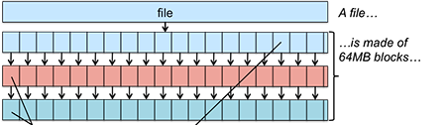
HDFS, S3
How to feed data into distributed parallel computation without bottleneck?
Good to have data also in a distributed, parallel storage.
Apache Hadoop Distributed File System, HDFS
Simple Storage Service, S3
Each file split into blocks.
3 copies of each block.
Blocks distributed among nodes.
Source: http://www.kalyanhadooptraining.com/2014/07/introduction-to-hadoop-ecosystem.html

Slide 55
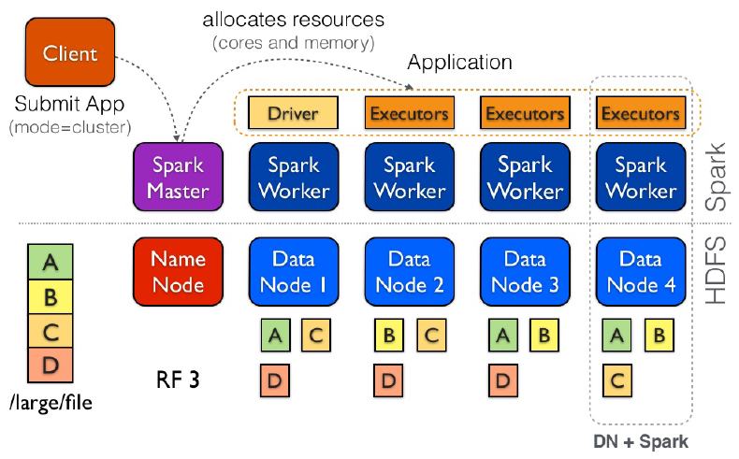
Spark and HDFS
Distributed Spark workers
Distributed data nodes
Often Spark and data share same machines
Ideally, worker fetches data from own data node
Source: http://www.kalyanhadooptraining.com/2014/07/introduction-to-hadoop-ecosystem.html
Notes:
For long this has been a typical setup in order to achieve data locality. Moving data between nodes was slow. This tends to change nowadays with networks getting even faster. Separating the worker nodes from the data nodes allows to scale up/down the worker nodes dynamically while keeping the number of data nodes constant.

Slide 56
Agenda
Simple BI application in Excel
Same in SQL
Scaling-up vertically vs. scaling-out horizontally
Translation to MapReduce
A more complete example
MapReduce, Hadoop, Hive
Spark, SparkSQL
Distributed Storage
Summary

Slide 57
Summary
BI-analyses well parallelizable to MR or Spark.
Scaling out to overcome bottlenecks.
Data ingest via parallel storage, e.g. S3, HDFS.
Analyst front-end SQL stays basically the same.
But new learnings for performance optimizations needed.

Slide 58
Thank you!
Questions?

